Slide 1
CORPORACION FAVORITA GROCERY SALES FORECASTING
Dain Thengunnal
10-02-2021

Slide 2
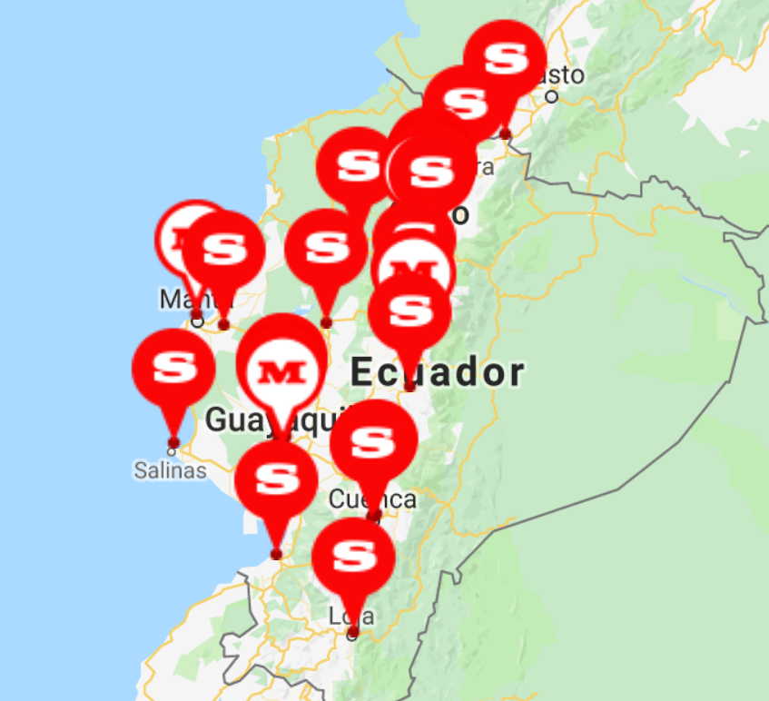
About
Corporacion Favorita is a large Ecuadorian-based grocery retailer who operates 54 supermarkets across multiple cities in Ecuador.

Slide 3
Problem
There is a delicate balance between purchasing and sales forecasting.
Subjective forecasting methods leads to overstocking or understocking.
overstocking results in wastage
understocking results in customer dissatisfaction

Slide 4
Challenge
Build a machine learning model that accurately predicts unit sales for an item, store and date.

Slide 5
ML Pipeline
Load and Understand
Data
Exploratory Data Analysis
Data
Cleaning
Feature
Engineering
Convert Categorical Features
Reporting
Evaluation of
prediction results
Predict and Score for each item family
Build models for each item family
Split data based on item family

Slide 6
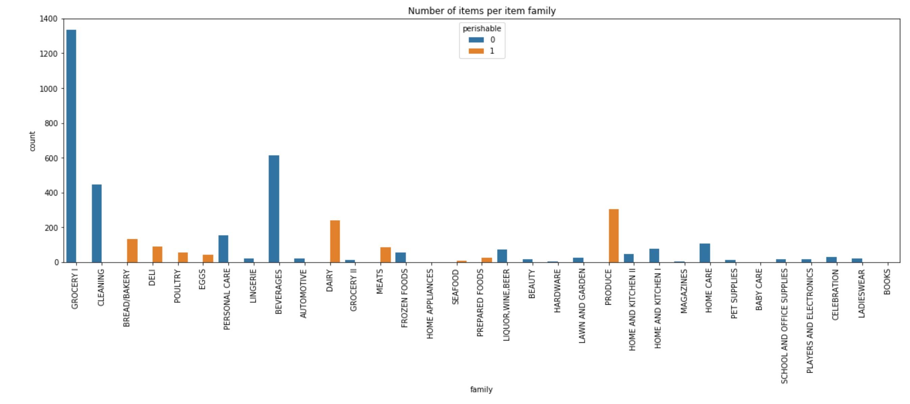
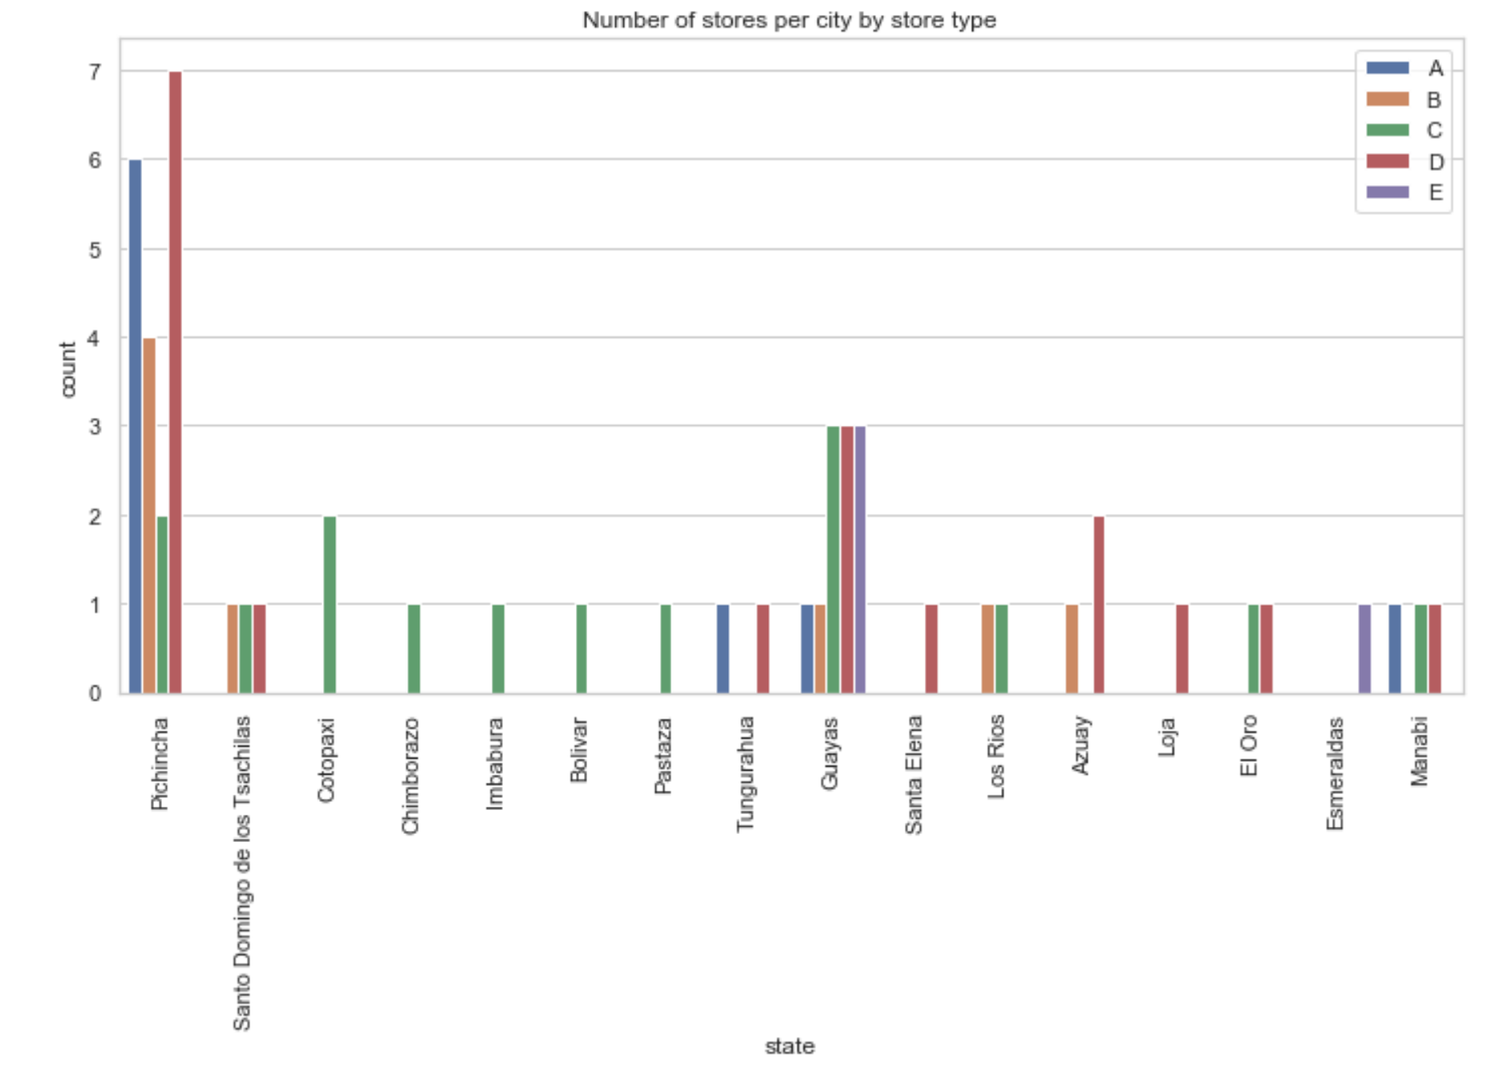
Exploratory Data Analysis

Slide 7
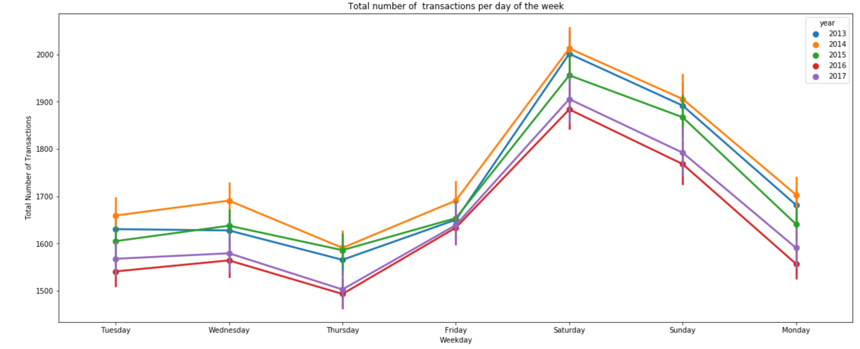
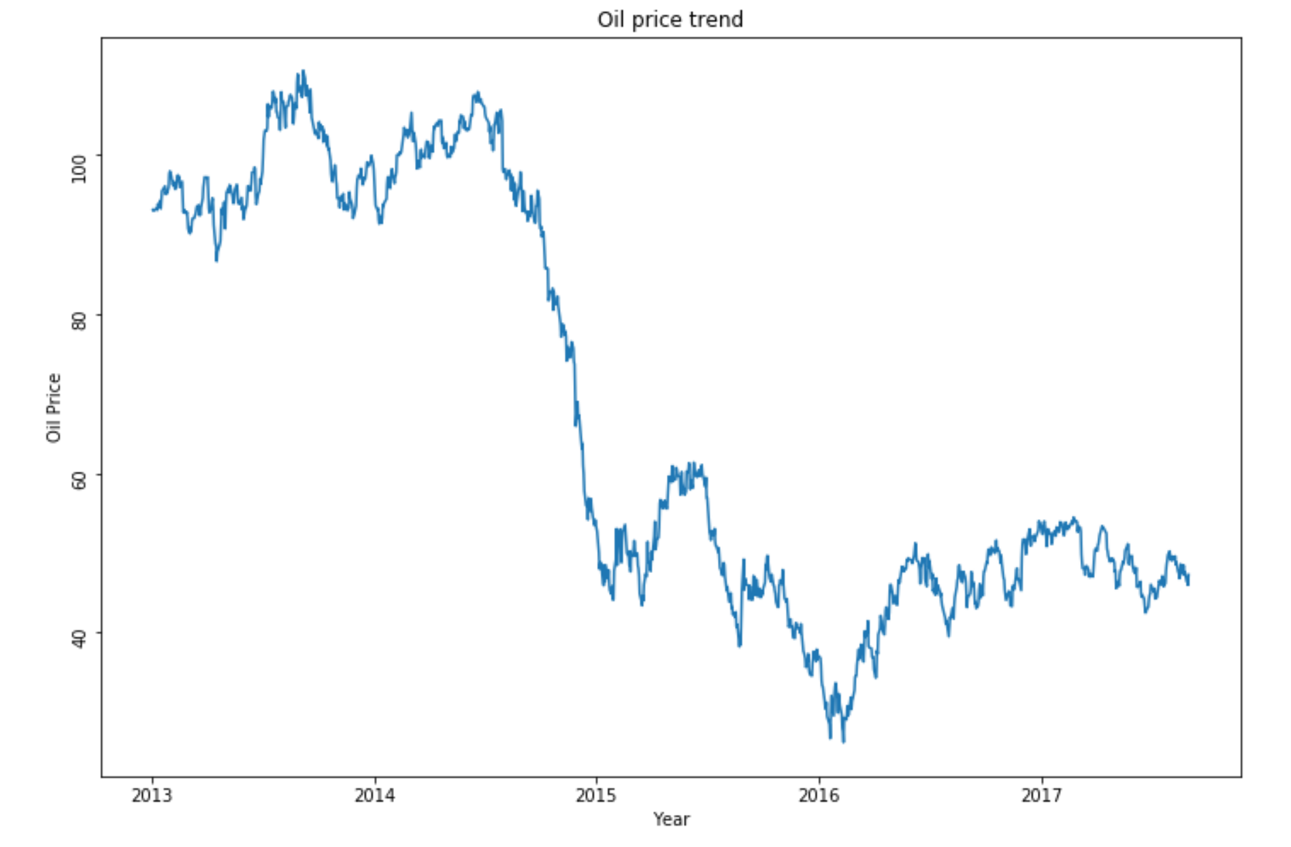

Slide 8
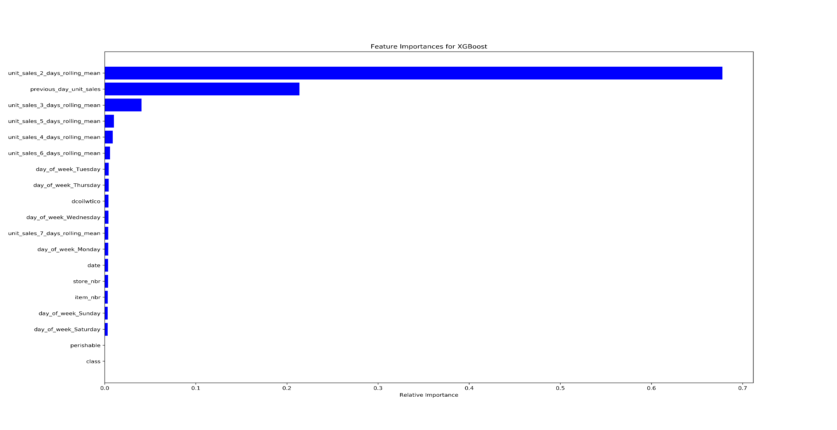
Solution
Predicted unit sales for each item family using the following features:

Slide 9
Models used
Following models were scored for each item family.
Linear Regression
Decision Tree
Support Vector Machine
Random Forest
XGBoost

Slide 10
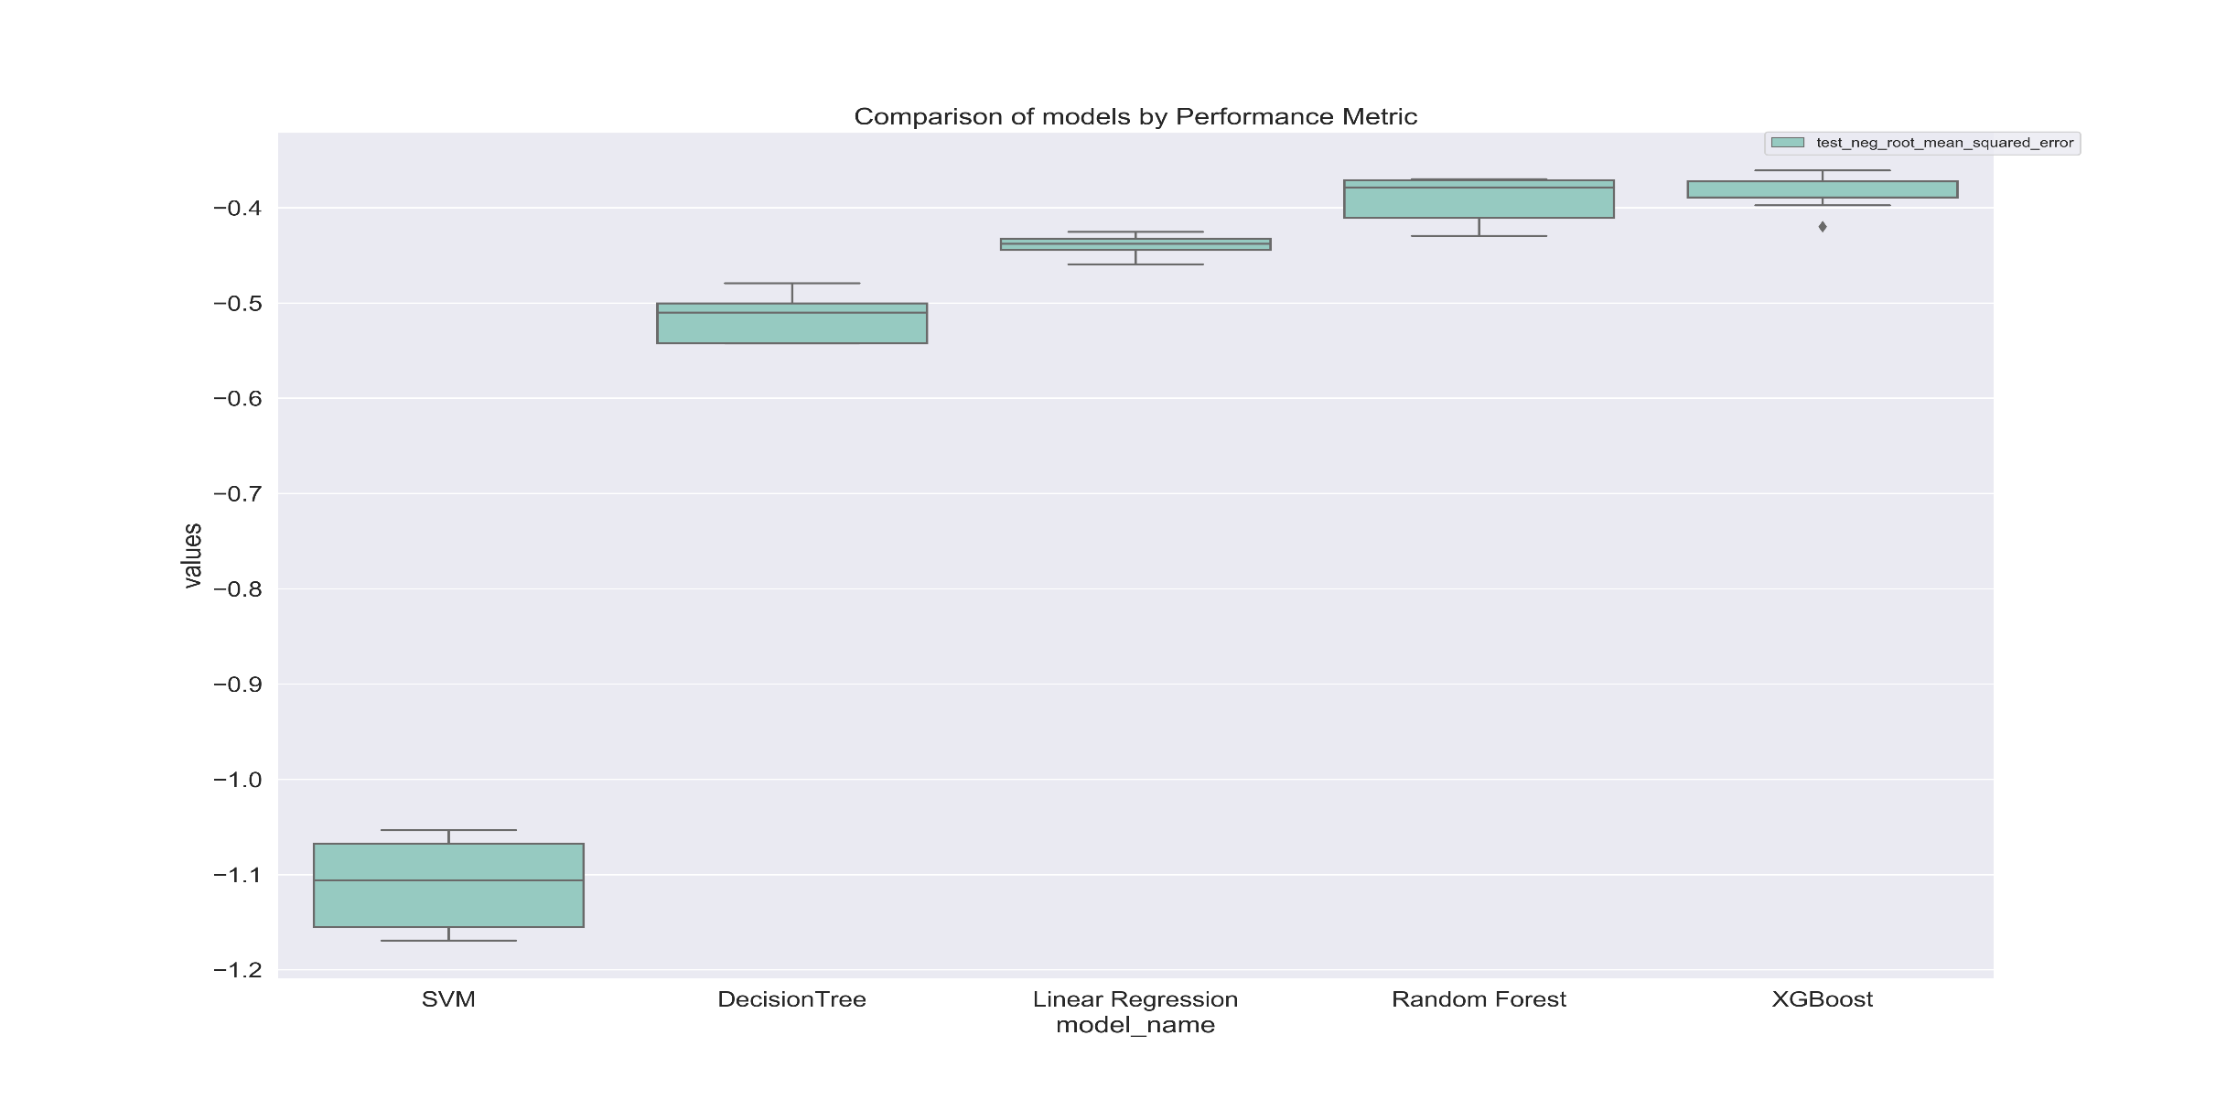
Comparison of models
Performance Metric: RMSE

Slide 11
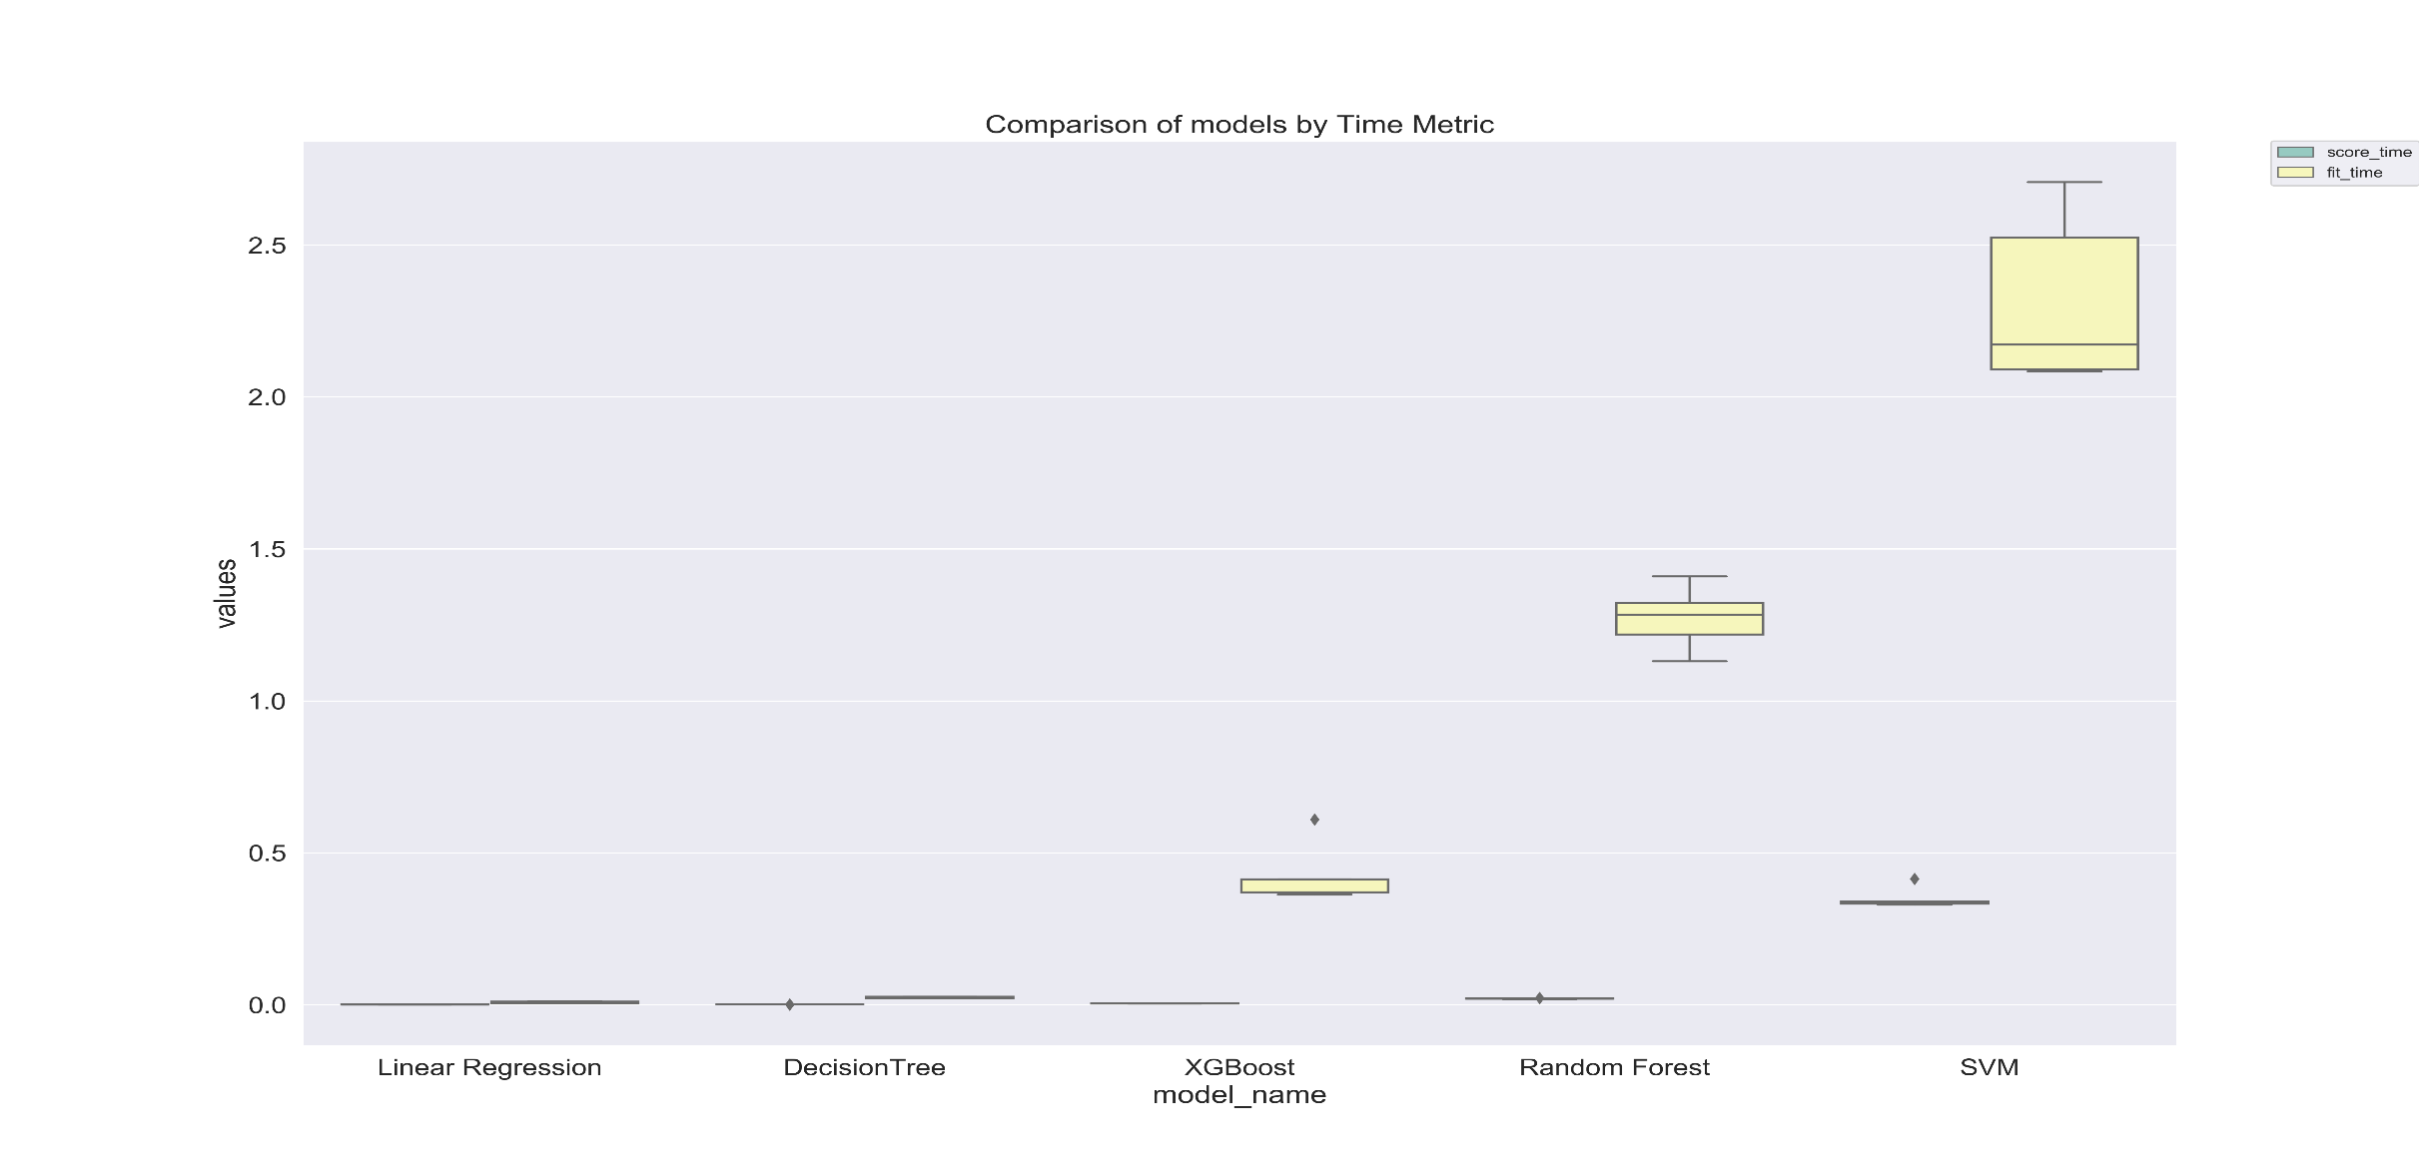
Time Metrics: Fit time, Score time

Slide 12
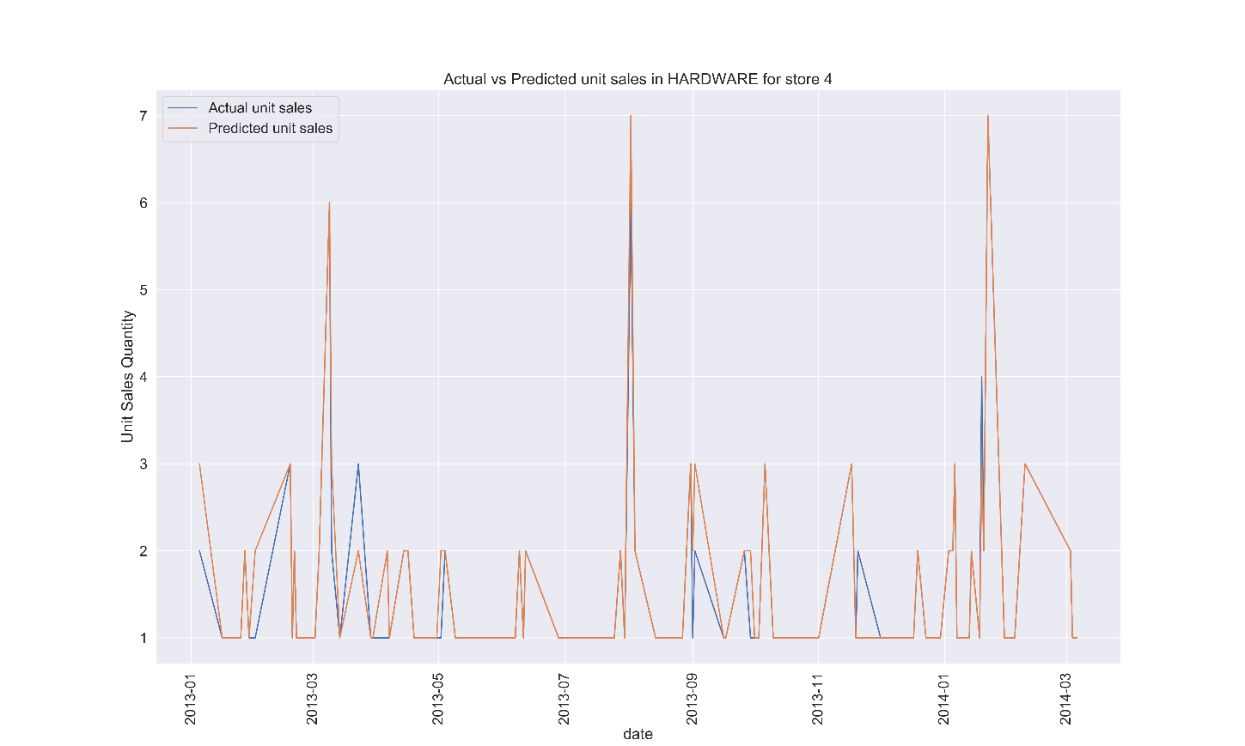
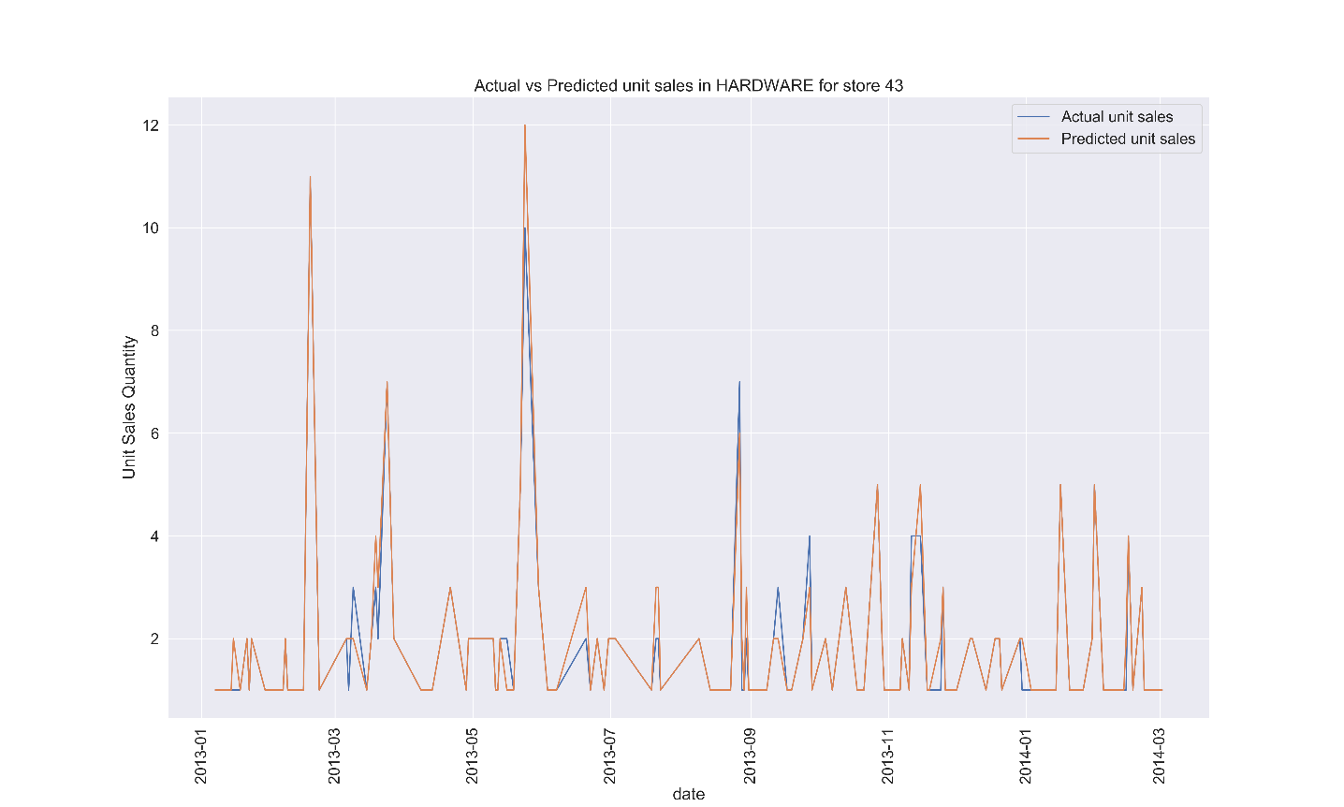
Result
Predicted unit sales for each item family with minimal error.
e.g. for item family Hardware
Model=XGBoost, RMSE=0.38105, SI=0.25568, Explained Variance Score=0.86320

Slide 13
Limitations
Only 16% of training data( 20 million records) were used for training due to system memory limitations.

Slide 14
Areas of Improvement
Tune model parameters
Build additional models
Blend weather and demographics
Use bigger sample size for training

Slide 15
Source code
https://github.com/logicshare/Favorita_sales_forecasting

